Slide 1
Amazon Graph-Based LLM
By,
Kiran Sheena Jyothi, Hanwei Hu, Yuexin Chen, Han Wen Liang, Sharika Mahadevan

Slide 2
Problem Statement

Slide 3
Challenge
Interpreting and querying Border Gateway Protocol (BGP) data in graph databases like Neo4j often requires specialized knowledge, which limits accessibility to experts.
Goal
Assess if Large Language Models (LLMs) can transform natural language queries into precise and executable graph database operations for BGP data analysis. Additionally, we aim to explore LLMs' ability to conduct comparative analysis between similar BGP data structures.
Potential Impact
Innovate BGP data understanding and benefit Amazon's research team by elevating the accessibility and analytical depth of network data across their diverse operational spectrum.

Slide 4
Data and Methods

Slide 5
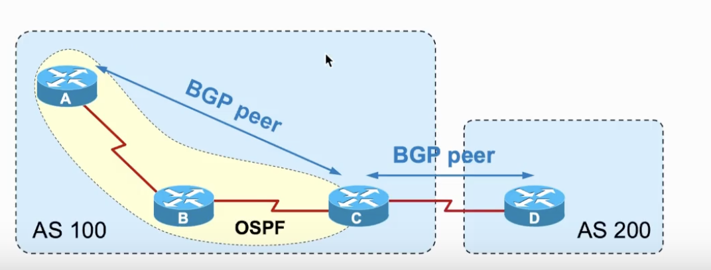
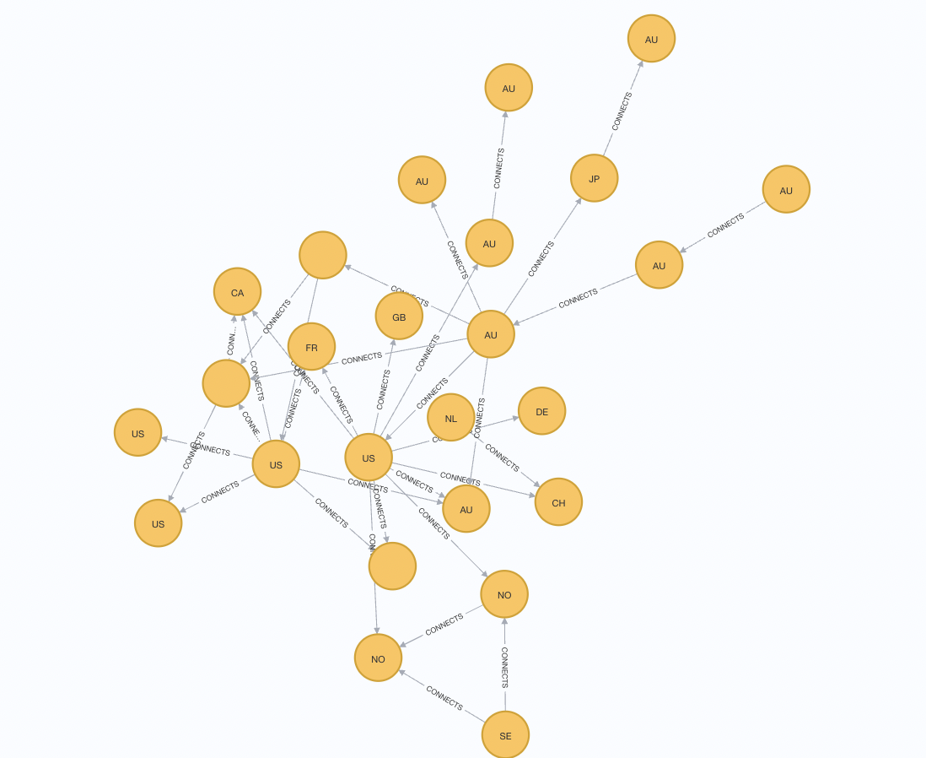
Bviews Data(RIP)
AS Number: A unique identifier assigned to each AS.
AS Name: The name of the organization managing the AS.
Peers: Other AS with which it has a direct BGP relationship.
Upstreams: Larger AS to which it connects to reach parts of the internet not within its immediate network.
Downstreams: Smaller AS or networks that connect to it for internet access.
Country: country of AS organization
City: city of AS organization

Slide 6
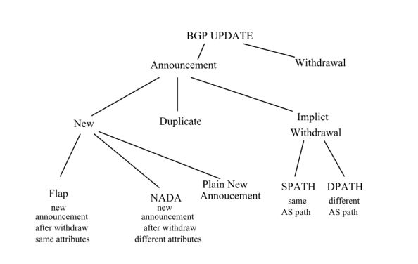
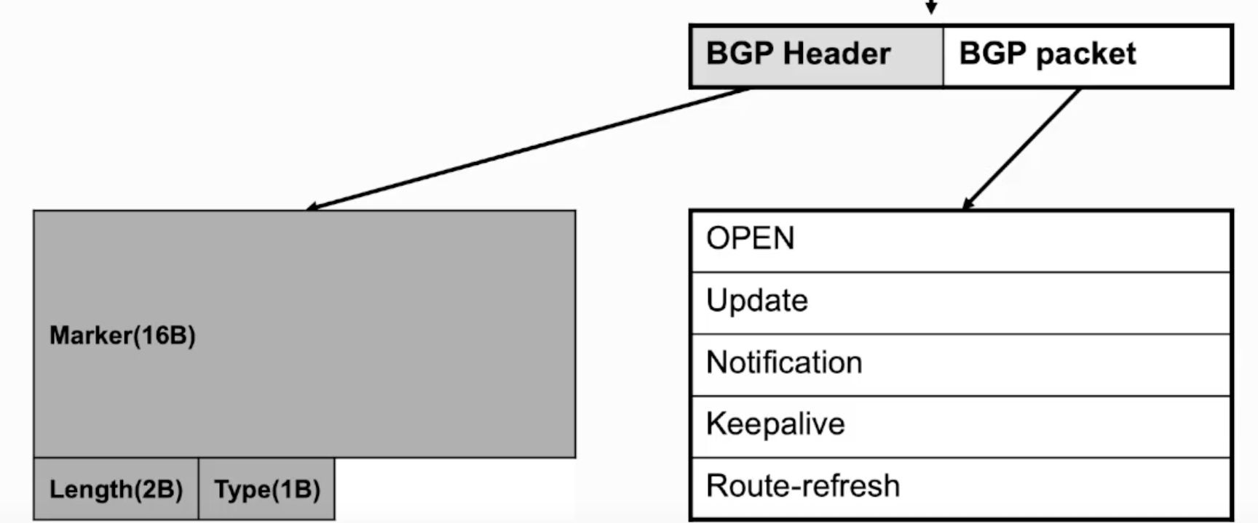
BGP Updates
Messages exchanged between BGP routers to inform each other of the availability, reachability, and optimal routes to different network prefixes on the internet.
Route Announcement: Contains new routing information, including network prefixes, AS path, next-hop IP address, and other path attributes.
Route Withdrawal: Indicates that a previously valid route is no longer available.
Path Attributes: Provide additional information about the route, such as the originating AS, local preference, and multi-exit discriminators.
Path Length: The number of autonomous systems (AS) that an update passes through before reaching its destination.
Message length: The size of the BGP update message in bytes, which includes the route advertisement or withdrawal information and any path attributes.

Slide 7
Data on Neo4j
BGP Preview is stored for each time stamp
Node type is set as Node_<timestamp>
So, each timestamp will have a disjoint graph which includes the required ASNs.
Source: https://ris.ripe.net/docs/ (The data is generated three times a day - every 8 hours.)

Slide 8
LangChain graph implementation
LangChain allows users to leverage LLMs like OpenAI’s GPT-3.5 turbo to build custom systems tailored to specific use cases.
BGP structure is stored as a graph in Neo4j.
Philosophy: graph is a standalone object, and LLM generates answer based on information retrieved from the graph
Create Cypher queries for information retrieval based on graph schema.
Summarize Neo4j output from Cypher query.
Answer user prompts based on generated Cypher query and response from Neo4j.
Shortest path
Number of paths
Graph statistics
Notes:
Henry

Slide 9
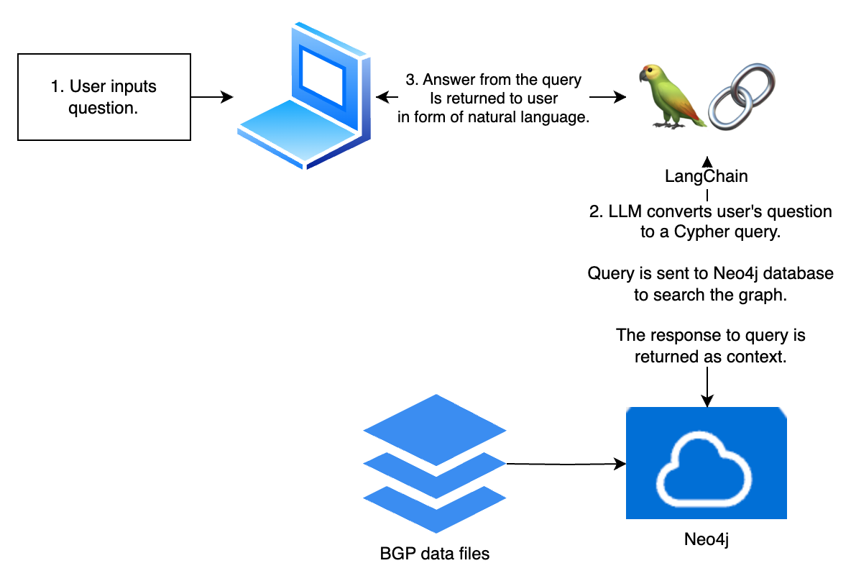
Overview of Langchain implementation
Notes:
Henry

Slide 10
Why we need a custom chain
LangChain although easy to implement, has the following issues
User input has to be sometimes specific and clear
Generated cypher queries can be incorrect
User output may not be coherent
Developing a custom chain allows us to fine tune the prompts according to our requirements
The precision of user input can also be enhanced to decrease ambiguity and the overall user experience
An error feedback loop can be constructed to improve accuracy of cypher queries
Migration to other systems would also be made easier.

Slide 11
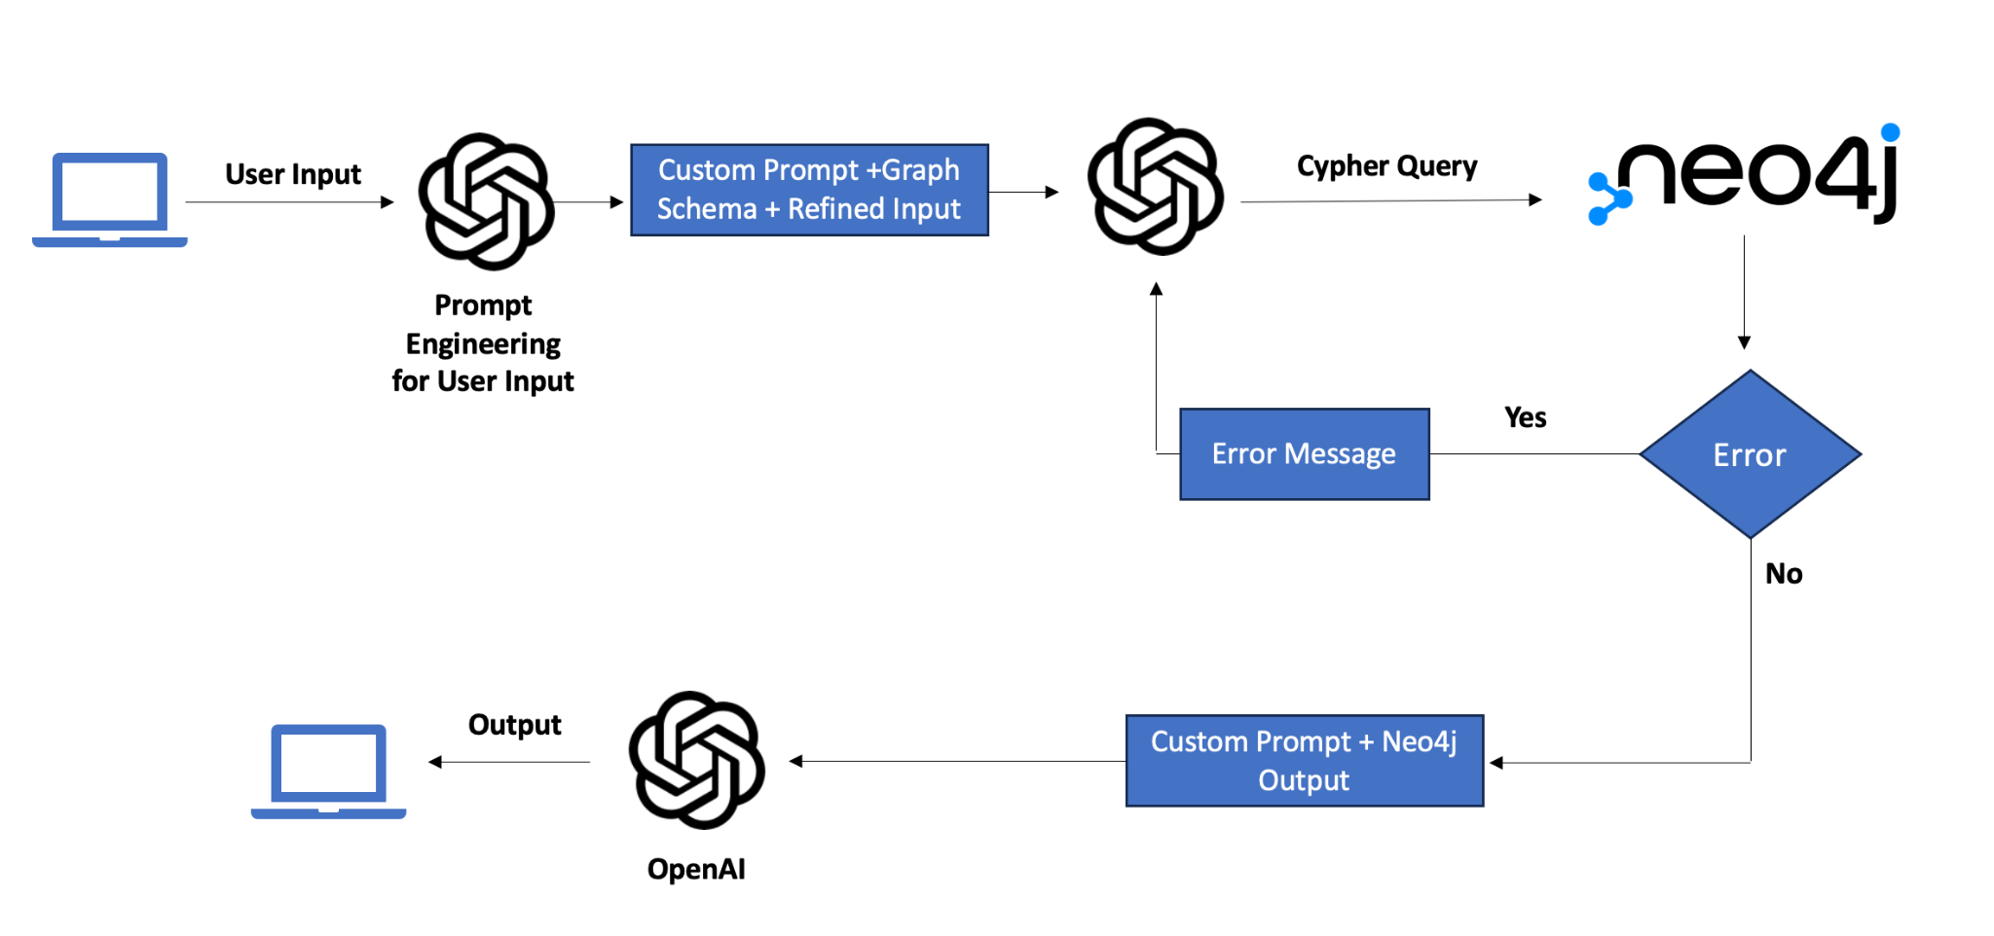
Final model

Slide 12
Insights

Slide 13
Summary
Properties | Prompt | Capable?
Number of Nodes | How many nodes are there of type <node_type>? | Yes
Number of edges | How many edges are there between the nodes with type <node_type>? | Yes
Isolated nodes | Are there any isolated nodes of type <node_type> in the network? Can you mention their ids? | Yes
Notes:
Results were checked against correct output

Slide 14
Summary
Properties | Prompt | Capable?
Indegree | Consider all nodes of node type <insert node type> (ex. Node_201511060000) and relationship as <insert relationship type> (ex. CONNECTS_201511060000) as graph at time <insert time name> (ex. t1). What is the indegree of node <insert node name> (ex. 22804) at <insert time name> (ex. t1)? | Yes
Change in Indegree | Consider all nodes of node type <insert node type> (ex. Node_201511060000) and relationship as <insert relationship type> (ex. CONNECTS_201511060000) as graph at time <insert time name> (ex. t1) and all nodes of type <insert node type> (ex. Node_201511060800) and relationship as <insert relationship type> (ex. CONNECTS_201511060800) as graph at time <insert time name> (ex. t2). Between t1 and t2, what is the change in indegree for node <insert node name> (ex. 48479)? | Yes
Notes:
Results were checked against correct output

Slide 15
Summary
Properties | Prompt | Capable?
Outdegree | Consider all nodes of node type <insert node type> (ex. Node_201511060000) and relationship as <insert relationship type> (ex. CONNECTS_201511060000) as graph at time <insert time name> (ex. t1). What is the outdegree of node <insert node name> (ex. 22804) at <insert time name> (ex. t1)? | Yes
Change in Outdegree | Consider all nodes of node type <insert node type> (ex. Node_201511060000) and relationship as <insert relationship type> (ex. CONNECTS_201511060000) as graph at time <insert time name> (ex. t1) and all nodes of type <insert node type> (ex. Node_201511060800) and relationship as <insert relationship type> (ex. CONNECTS_201511060800) as graph at time <insert time name> (ex. t2). Between t1 and t2, what is the change in outdegree for node <insert node name> (ex. 48479)? | Yes
Notes:
Results were checked against correct output

Slide 16
Summary
Properties | Prompt | Capable?
Path existence | Does a path exist from node <insert node name> (e.g -28625) to node <insert node name>(e.g - 2828) for nodes of type <insert node type> (e.g - node_201511060000)? If so what is the path in terms of node id? | Yes
Path length | What are the paths from <insert node name> (e.g -1251) to node <insert node name>(e.g - 4844) for nodes of type <insert node type> (e.g - node_201511060000)? Also, return the path length of each path. | Yes
Notes:
Results were checked against correct output

Slide 17
Summary
Properties | Prompt | Capable?
Change in Shortest Path | Consider all nodes of node type <insert node type> (ex. Node_201511060000) and relationship as <insert relationship type> (ex. CONNECTS_201511060000) as graph at time <insert time snapshot name> (ex. t1) and all nodes of type <insert node type> (ex. Node_201511060800) and relationship as <insert relationship type> (ex. CONNECTS_201511060800) as graph at time <insert time snapshot name> (ex. t2). Between t1 and t2, have the shortest paths from <insert node name > (e.g 31133) to <insert node name> (e.g 4777) changed? If so, how did it change? | Yes
Notes:
Results were checked against correct output

Slide 18
Summary
Properties | Prompt | Capable?
Change in number of Path | Consider all nodes of node type <insert node type> (ex. Node_201511060000) and relationship as <insert relationship type> (ex. CONNECTS_201511060000) as graph at time <insert time snapshot name> (ex. t1) and all nodes of type <insert node type> (ex. Node_201511060800) and relationship as <insert relationship type> (ex. CONNECTS_201511060800) as graph at time <insert time snapshot name> (ex. t2). Between t1 and t2, are there any change in number of paths from <insert node name > (e.g 28625) to <insert node name> (e.g 50300)? | Yes
Notes:
Results were checked against correct output

Slide 19
Summary
Properties | Prompt | Capable?
Comparison between Current and shortest path | If the current path from <insert node name> (e.g 1251) to <insert node name> (e.g 4844) is <insert path sequence> (e.g -1251-28625-12989-6762-3356-2914-4844) for node type <insert node type> (e.g -Node_201511060000), What is the shortest path possible and what is the difference? | Yes
Notes:
Results were checked against correct output

Slide 20
Summary
Properties | Prompt | Capable?
Change in Path | Consider all nodes of node type <insert node type> (ex. Node_201511060000) and relationship as <insert relationship type> (ex. CONNECTS_201511060000) as graph at time <insert time snapshot name> (ex. t1) and all nodes of type <insert node type> (ex. Node_201511060800) and relationship as <insert relationship type> (ex. CONNECTS_201511060800) as graph at time <insert time snapshot name> (ex. t2). Between t1 and t2, have the paths from <insert node name > (e.g 28625) to <insert node name> (e.g 4608) changed? If so, how did it change? | Sometimes it can return a path change when multiple paths exist
Notes:
Results were checked against correct output

Slide 21
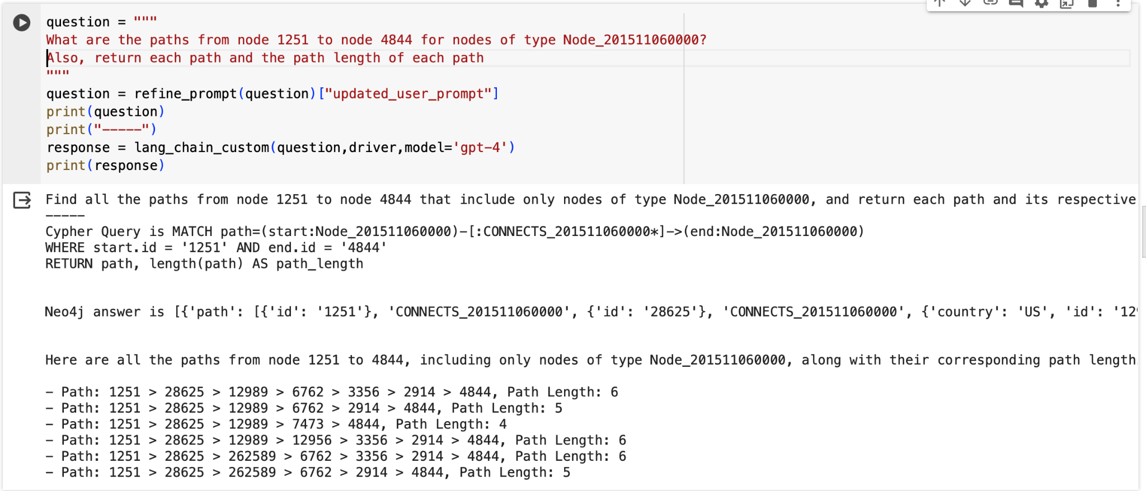
Paths and Path length - Output

Slide 22
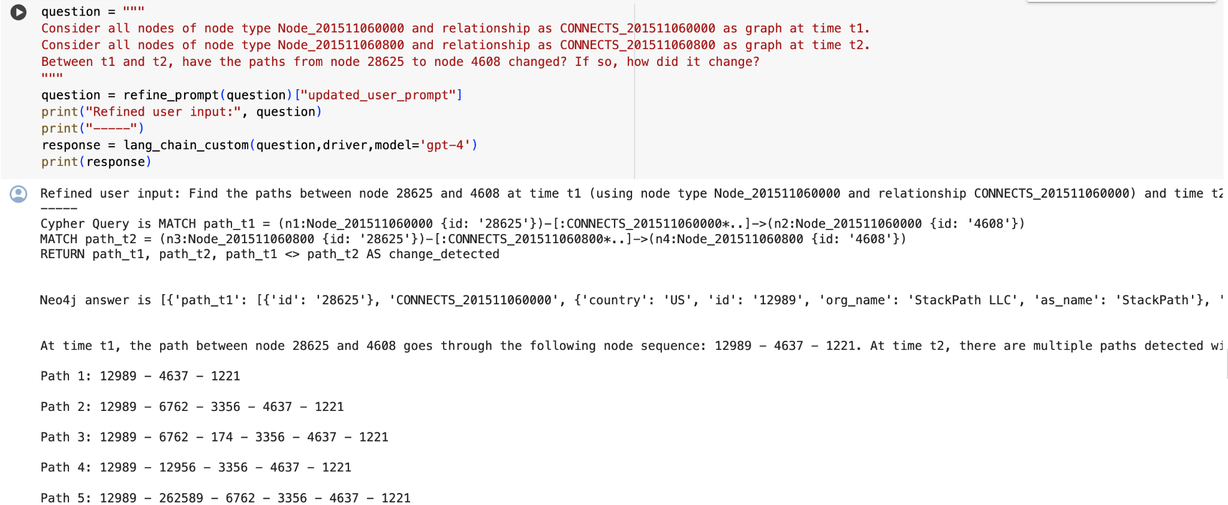
Change in Path - Output

Slide 23
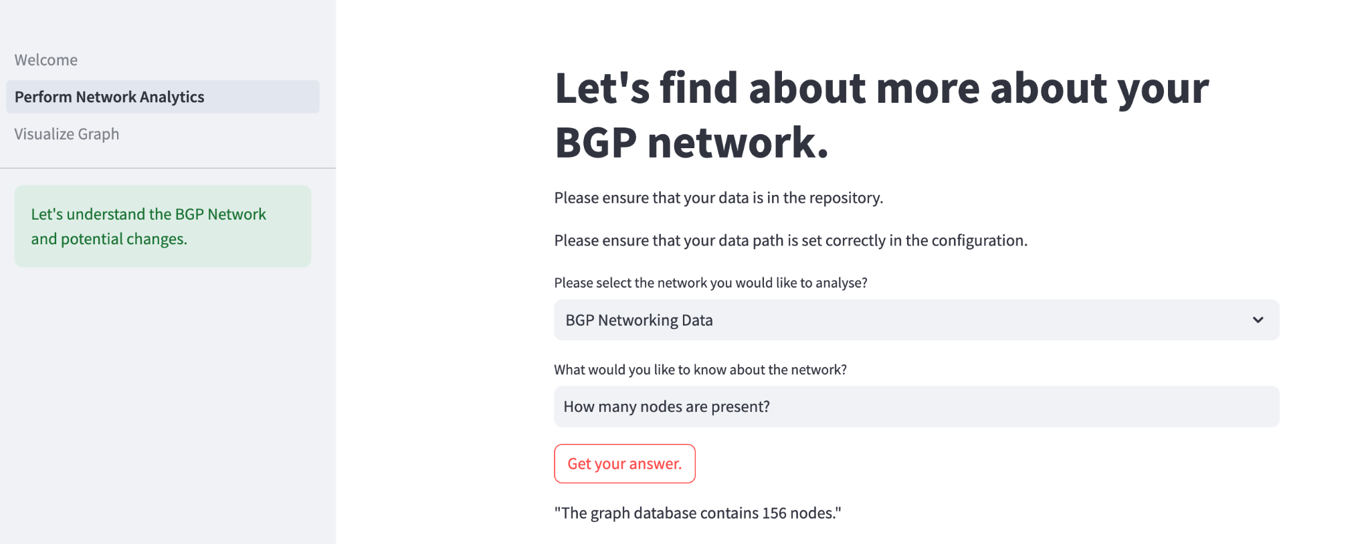
Streamlit Application

Slide 24
Application & Cost Estimate
Assuming we store 100 snapshots at a time and we make 50 queries per day, we get the following cost estimate for the different applications.
Service | Cost
Neo4j | $ 2073.60 per month
OpenAI | $ 477 per month
ECS | $ 32.74 per month

Slide 25
Conclusion
Current prototype is able to effectively analyze BGP networks for most graph based applications
Future versions could make the following improvements
Incorporate a feedback loop to refine the LLM output for handling the token limit of gpt-4
Create a timeout mechanism for seamless usage
Users could also experiment with different database systems and LLM by easily modifying the developed functions.

Slide 26
Thank You

Slide 27
Appendix

Slide 28
LLM Learning Approach and Limitations
Philosophy: LLM understands graph description and answers user questions based on the graph description
Attempts
Refining graph description and user prompts.
Fine tuning (few-shot learning) through OpenAI API
Limitations
Graph description refinement did not improve accuracy of the answers, and model output was unstable. This could be due to the graph description being too long and the model being unable to have such a long context window, or that the model (GPT-4) did not have many training instances of descriptions of graphs, which causes it to have high perplexity and be unable to generalize in our use case.
Fine tuning with graph description and question – desired answer pairs improved accuracy significantly, but the token length of 4096 severely limited the possible graphs we can use to fine tune the model. The maximum graph size without exceeding the token limit was 35 nodes.

Slide 29
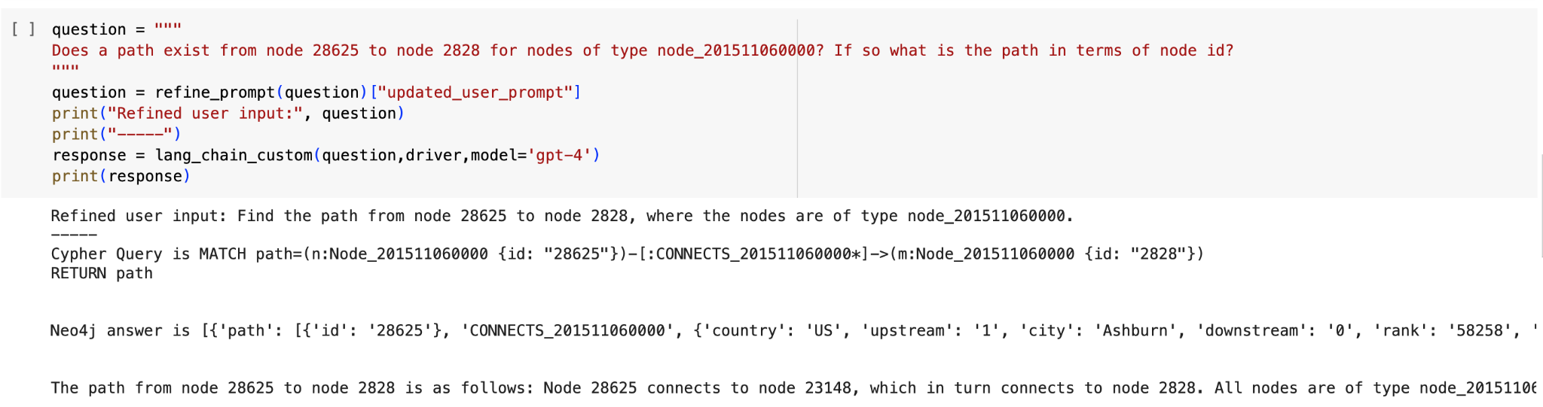
Path Existence

Slide 30
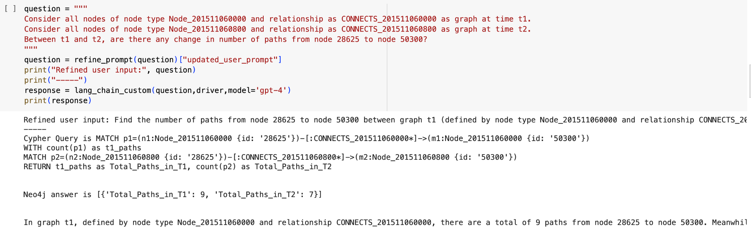
Change in Number of Paths

Slide 31
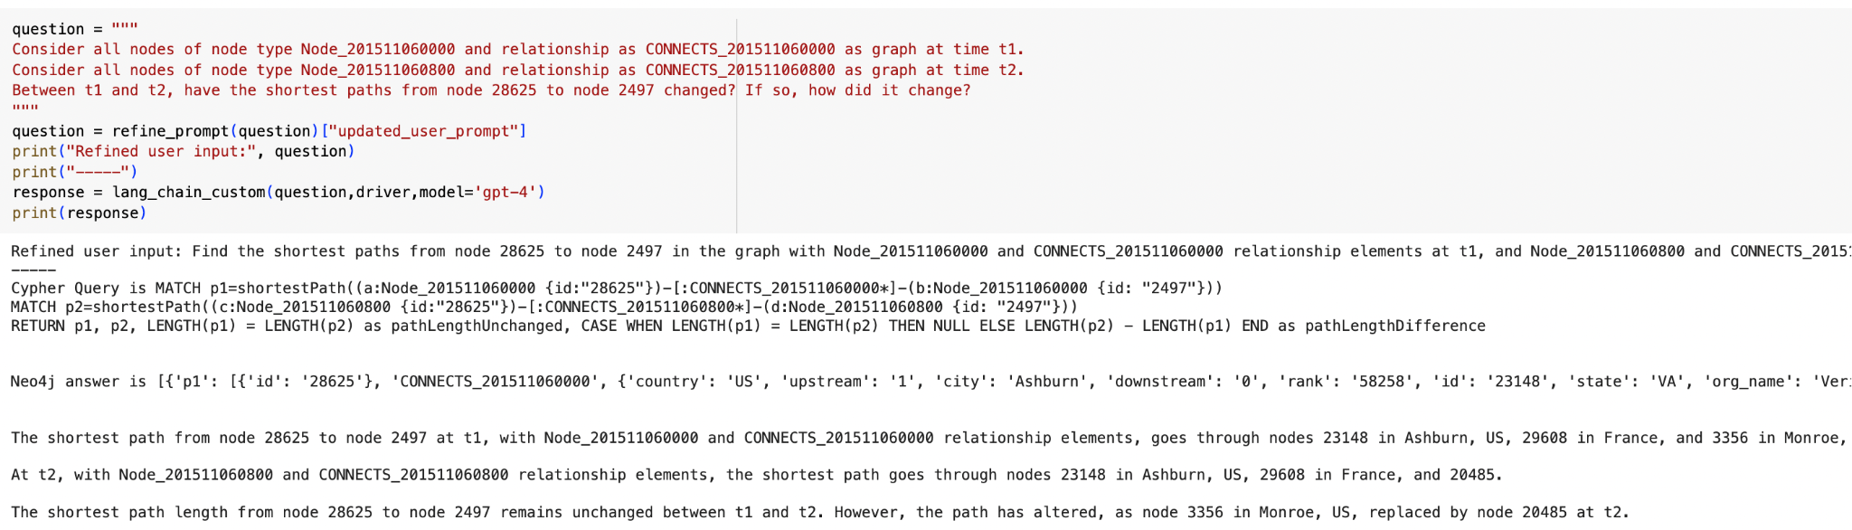
Change in Shortest Path

Slide 32
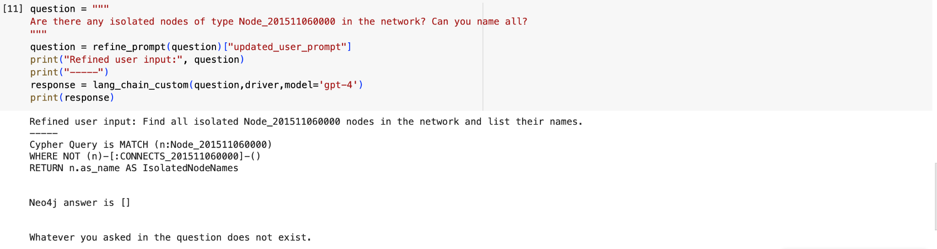
Isolated Nodes

Slide 33
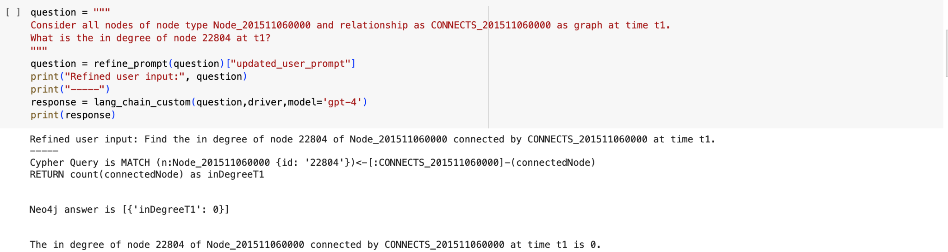
In degree

Slide 34
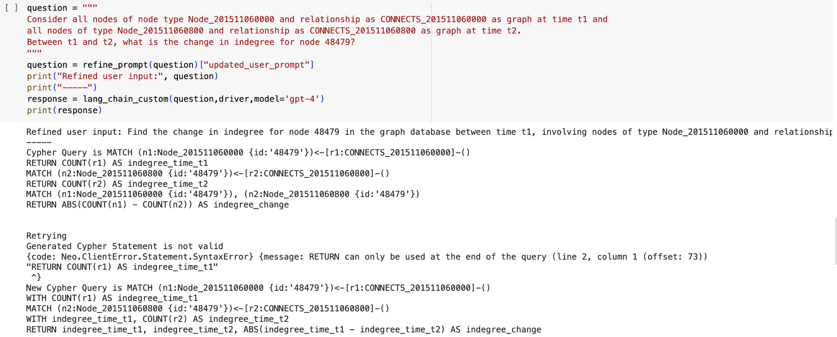
Change in In degree

Slide 35
Total Costs
Monthly Neo4j Premium costs: $2073.63
32GB RAM
6 CPU
64GB storage
Monthly ECS costs: $32.74
10 tasks
1h per session
2vCPU
6GB RAM
Monthly OpenAI costs: $477
100 graphs stored at all times,
Each new snapshot is compared with every another graph
50 queries run per day

